Slide 1
An Introduction to Dynamic Programming
Rhian Davies

Slide 2
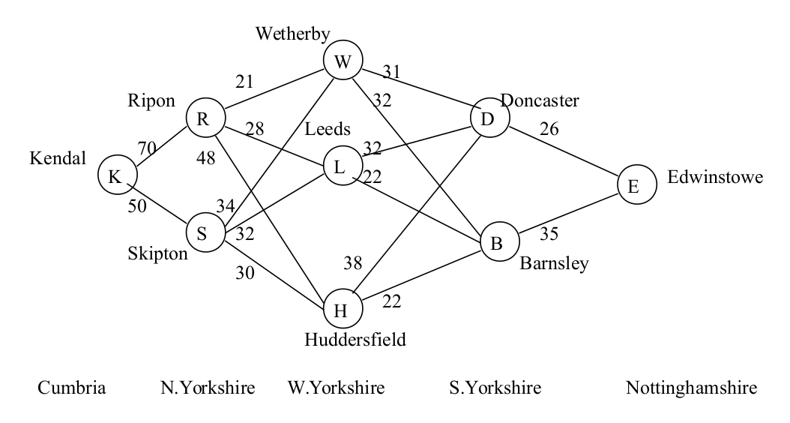

Slide 3
K R W D E = 148
K R W B E = 158
K R L D E = 156
K R L B E = 155
K R H D E = 182
K R H B E = 175
K S W D E = 141
K S W B E = 151
K S L D E = 140
K S L B E = 139
K S H D E = 144
K S H B E = 137

Slide 4
Stage 1. (South Yorkshire)
From D, the distance to E is 26 miles.
From B, the distance to E is 35 miles.
Stage 2. (West Yorkshire)
From W, the route through D to E is 31 + 26 = 57 miles.
From W, the route through B to E is 32 + 35 = 67 miles.
From L, the route through D to E is 32 + 26 = 58 miles.
From L, the route through B to E is 22 + 35 = 57 miles.
From H, the route through D to E is 38 + 26 = 64 miles.
From H, the route through B to E is 22 + 35 = 57 miles.
Stage 3. (North Yorkshire)
From R, the shorter route through W is 21 + 57 = 78 miles.
From R, the shorter route through L is 28 + 57 = 85 miles.
From R, the shorter route through H is 48 + 57 = 105 miles.
From S, the shorter route through W is 34 + 57 = 91 miles.
From S, the shorter route through L is 32 + 57 = 89 miles.
From S, the shorter route through H is 30 + 57 = 87 miles.
Stage 4. (Cumbria)
From K, the shortest route through R is 70 + 78 = 148 miles.
From K, the shortest route through S is 50 + 87 = 137 miles.

Slide 5
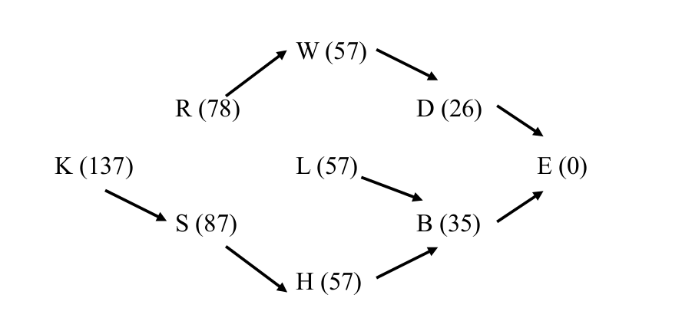

Slide 6
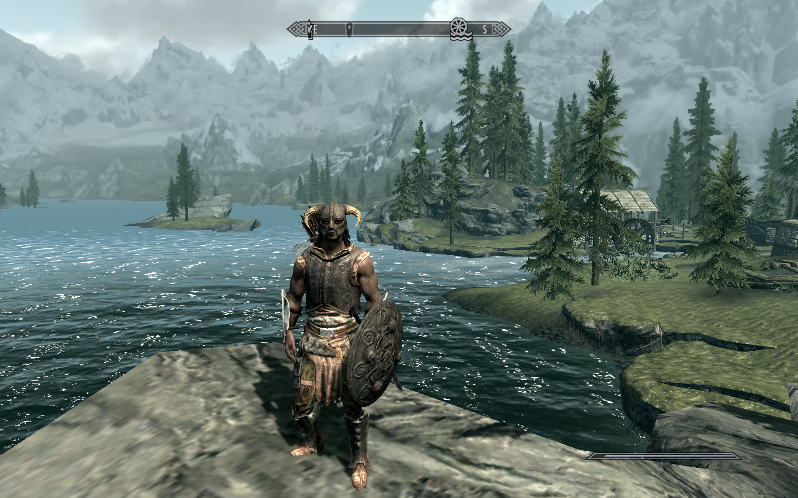

Slide 7
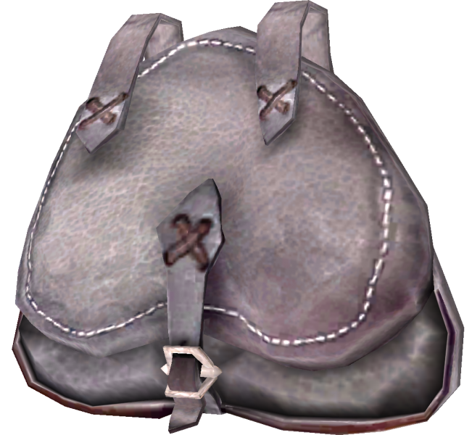
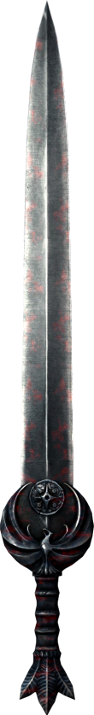
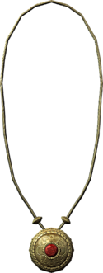
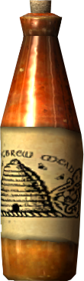
Knapsack capacity = 5kg
 | Blade | Beer | Golden Necklace
Value | £5 | £3 | £4
Weight | 3kg | 2kg | 1kg

Slide 8

Value | 0 | 1 | 2 | 3 | 4 | 5
0
1
2
3
Value = £5
Weight = 3kg
Keep | 0 | 1 | 2 | 3 | 4 | 5
0
1
2
3
Value = £3
Weight = 2kg
Value = £4
Weight = 1kg
Notes:
Initial Table

Slide 9
Value | 0 | 1 | 2 | 3 | 4 | 5
0
1
2
3
Value = £5
Weight = 3kg
Keep | 0 | 1 | 2 | 3 | 4 | 5
0
1
2
3
Value = £3
Weight = 2kg
Value = £4
Weight = 1kg
Notes:
Each cell in the Value table represents a smaller knapsack problem e.g this is a knapsack with capacity of 2kg, and the only possible item is item 1

Slide 10
Value | 0 | 1 | 2 | 3 | 4 | 5
0
1
2
3
Value = £5
Weight = 3kg
Keep | 0 | 1 | 2 | 3 | 4 | 5
0
1
2
3
Value = £3
Weight = 2kg
Sword
Value = £4
Weight = 1kg
Notes:
Where we are trying to get to

Slide 11
Value | 0 | 1 | 2 | 3 | 4 | 5
0 | 0 | 0 | 0 | 0 | 0 | 0
1
2
3
Value = £5
Weight = 3kg
Keep | 0 | 1 | 2 | 3 | 4 | 5
0 | 0 | 0 | 0 | 0 | 0 | 0
1
2
3
Value = £3
Weight = 2kg
Value = £4
Weight = 1kg
Notes:
Basecase – it’s obvious. If we have no items – best solution is to put no items in (independent of knapsack size)

Slide 12
Value | 0 | 1 | 2 | 3 | 4 | 5
0 | 0 | 0 | 0 | 0 | 0 | 0
1 | 0
2
3
Value = £5
Weight = 3kg
Keep | 0 | 1 | 2 | 3 | 4 | 5
0 | 0 | 0 | 0 | 0 | 0 | 0
1 | 0
2
3
Value = £3
Weight = 2kg
Value = £4
Weight = 1kg
Notes:
Work from top left to bottom right. Knapsack. Capacity of 1, just item 1. Does the item fit?

Slide 13
Value | 0 | 1 | 2 | 3 | 4 | 5
0 | 0 | 0 | 0 | 0 | 0 | 0
1 | 0 | 0
2
3
Value = £5
Weight = 3kg
Keep | 0 | 1 | 2 | 3 | 4 | 5
0 | 0 | 0 | 0 | 0 | 0 | 0
1 | 0 | 0
2
3
Value = £3
Weight = 2kg
Value = £4
Weight = 1kg
Notes:
Work from top left to bottom right. Knapsack. Capacity of 1, just item 1. Does the item fit?

Slide 14
Value | 0 | 1 | 2 | 3 | 4 | 5
0 | 0 | 0 | 0 | 0 | 0 | 0
1 | 0 | 0 | 5
2
3
Value = £5
Weight = 3kg
Keep | 0 | 1 | 2 | 3 | 4 | 5
0 | 0 | 0 | 0 | 0 | 0 | 0
1 | 0 | 0 | 1
2
3
Value = £3
Weight = 2kg
Value = £4
Weight = 1kg

Slide 15
Value | 0 | 1 | 2 | 3 | 4 | 5
0 | 0 | 0 | 0 | 0 | 0 | 0
1 | 0 | 0 | 5 | 5
2
3
Value = £5
Weight = 3kg
Keep | 0 | 1 | 2 | 3 | 4 | 5
0 | 0 | 0 | 0 | 0 | 0 | 0
1 | 0 | 0 | 1 | 1
2
3
Value = £3
Weight = 2kg
Value = £4
Weight = 1kg

Slide 16
Value | 0 | 1 | 2 | 3 | 4 | 5
0 | 0 | 0 | 0 | 0 | 0 | 0
1 | 0 | 0 | 5 | 5 | 5
2
3
Value = £5
Weight = 3kg
Keep | 0 | 1 | 2 | 3 | 4 | 5
0 | 0 | 0 | 0 | 0 | 0 | 0
1 | 0 | 0 | 1 | 1 | 1
2
3
Value = £3
Weight = 2kg
Value = £4
Weight = 1kg

Slide 17
Value | 0 | 1 | 2 | 3 | 4 | 5
0 | 0 | 0 | 0 | 0 | 0 | 0
1 | 0 | 0 | 5 | 5 | 5 | 5
2
3
Value = £5
Weight = 3kg
Keep | 0 | 1 | 2 | 3 | 4 | 5
0 | 0 | 0 | 0 | 0 | 0 | 0
1 | 0 | 0 | 1 | 1 | 1 | 1
2
3
Value = £3
Weight = 2kg
Value = £4
Weight = 1kg

Slide 18
Value | 0 | 1 | 2 | 3 | 4 | 5
0 | 0 | 0 | 0 | 0 | 0 | 0
1 | 0 | 0 | 5 | 5 | 5 | 5
2 | 0
3
Value = £5
Weight = 3kg
Keep | 0 | 1 | 2 | 3 | 4 | 5
0 | 0 | 0 | 0 | 0 | 0 | 0
1 | 0 | 0 | 1 | 1 | 1 | 1
2 | 0
3
Value = £3
Weight = 2kg
Value = £4
Weight = 1kg

Slide 19
Value | 0 | 1 | 2 | 3 | 4 | 5
0 | 0 | 0 | 0 | 0 | 0 | 0
1 | 0 | 0 | 5 | 5 | 5 | 5
2 | 0 | 0
3
Value = £5
Weight = 3kg
Keep | 0 | 1 | 2 | 3 | 4 | 5
0 | 0 | 0 | 0 | 0 | 0 | 0
1 | 0 | 0 | 1 | 1 | 1 | 1
2 | 0 | 0
3
Value = £3
Weight = 2kg
Value = £4
Weight = 1kg

Slide 20
Value | 0 | 1 | 2 | 3 | 4 | 5
0 | 0 | 0 | 0 | 0 | 0 | 0
1 | 0 | 0 | 5 | 5 | 5 | 5
2 | 0 | 0 | 3
3
Value = £5
Weight = 3kg
Keep | 0 | 1 | 2 | 3 | 4 | 5
0 | 0 | 0 | 0 | 0 | 0 | 0
1 | 0 | 0 | 1 | 1 | 1 | 1
2 | 0 | 0 | 1
3
Value = £3
Weight = 2kg
Value = £4
Weight = 1kg

Slide 21
Value | 0 | 1 | 2 | 3 | 4 | 5
0 | 0 | 0 | 0 | 0 | 0 | 0
1 | 0 | 0 | 5 | 5 | 5 | 5
2 | 0 | 0 | 3 | 5
3
Value = £5
Weight = 3kg
Keep | 0 | 1 | 2 | 3 | 4 | 5
0 | 0 | 0 | 0 | 0 | 0 | 0
1 | 0 | 0 | 1 | 1 | 1 | 1
2 | 0 | 0 | 1 | 0
3
Value = £3
Weight = 2kg
Value = £4
Weight = 1kg

Slide 22
Value | 0 | 1 | 2 | 3 | 4 | 5
0 | 0 | 0 | 0 | 0 | 0 | 0
1 | 0 | 0 | 5 | 5 | 5 | 5
2 | 0 | 0 | 3 | 5 | 5
3
Value = £5
Weight = 3kg
Keep | 0 | 1 | 2 | 3 | 4 | 5
0 | 0 | 0 | 0 | 0 | 0 | 0
1 | 0 | 0 | 1 | 1 | 1 | 1
2 | 0 | 0 | 1 | 0 | 0
3
Value = £3
Weight = 2kg
Value = £4
Weight = 1kg

Slide 23
Value | 0 | 1 | 2 | 3 | 4 | 5
0 | 0 | 0 | 0 | 0 | 0 | 0
1 | 0 | 0 | 5 | 5 | 5 | 5
2 | 0 | 0 | 3 | 5 | 5 | 8
3
Value = £5
Weight = 3kg
Keep | 0 | 1 | 2 | 3 | 4 | 5
0 | 0 | 0 | 0 | 0 | 0 | 0
1 | 0 | 0 | 1 | 1 | 1 | 1
2 | 0 | 0 | 1 | 0 | 0 | 1
3
Value = £3
Weight = 2kg
Value = £4
Weight = 1kg

Slide 24
Value | 0 | 1 | 2 | 3 | 4 | 5
0 | 0 | 0 | 0 | 0 | 0 | 0
1 | 0 | 0 | 5 | 5 | 5 | 5
2 | 0 | 0 | 3 | 5 | 5 | 8
3 | 0
Value = £5
Weight = 3kg
Keep | 0 | 1 | 2 | 3 | 4 | 5
0 | 0 | 0 | 0 | 0 | 0 | 0
1 | 0 | 0 | 1 | 1 | 1 | 1
2 | 0 | 0 | 1 | 0 | 0 | 1
3 | 0
Value = £3
Weight = 2kg
Value = £4
Weight = 1kg

Slide 25
Value | 0 | 1 | 2 | 3 | 4 | 5
0 | 0 | 0 | 0 | 0 | 0 | 0
1 | 0 | 0 | 5 | 5 | 5 | 5
2 | 0 | 0 | 3 | 5 | 5 | 8
3 | 0 | 4
Value = £5
Weight = 3kg
Keep | 0 | 1 | 2 | 3 | 4 | 5
0 | 0 | 0 | 0 | 0 | 0 | 0
1 | 0 | 0 | 1 | 1 | 1 | 1
2 | 0 | 0 | 1 | 0 | 0 | 1
3 | 0 | 1
Value = £3
Weight = 2kg
Value = £4
Weight = 1kg

Slide 26
Value | 0 | 1 | 2 | 3 | 4 | 5
0 | 0 | 0 | 0 | 0 | 0 | 0
1 | 0 | 0 | 5 | 5 | 5 | 5
2 | 0 | 0 | 3 | 5 | 5 | 8
3 | 0 | 4 | 4
Value = £5
Weight = 3kg
Keep | 0 | 1 | 2 | 3 | 4 | 5
0 | 0 | 0 | 0 | 0 | 0 | 0
1 | 0 | 0 | 1 | 1 | 1 | 1
2 | 0 | 0 | 1 | 0 | 0 | 1
3 | 0 | 1 | 1
Value = £3
Weight = 2kg
Value = £4
Weight = 1kg

Slide 27
Value | 0 | 1 | 2 | 3 | 4 | 5
0 | 0 | 0 | 0 | 0 | 0 | 0
1 | 0 | 0 | 5 | 5 | 5 | 5
2 | 0 | 0 | 3 | 5 | 5 | 8
3 | 0 | 4 | 4 | 7
Value = £5
Weight = 3kg
Keep | 0 | 1 | 2 | 3 | 4 | 5
0 | 0 | 0 | 0 | 0 | 0 | 0
1 | 0 | 0 | 1 | 1 | 1 | 1
2 | 0 | 0 | 1 | 0 | 0 | 1
3 | 0 | 1 | 1 | 1
Value = £3
Weight = 2kg
Value = £4
Weight = 1kg

Slide 28
Value | 0 | 1 | 2 | 3 | 4 | 5
0 | 0 | 0 | 0 | 0 | 0 | 0
1 | 0 | 0 | 5 | 5 | 5 | 5
2 | 0 | 0 | 3 | 5 | 5 | 8
3 | 0 | 4 | 4 | 7 | 9
Value = £5
Weight = 3kg
Keep | 0 | 1 | 2 | 3 | 4 | 5
0 | 0 | 0 | 0 | 0 | 0 | 0
1 | 0 | 0 | 1 | 1 | 1 | 1
2 | 0 | 0 | 1 | 0 | 0 | 1
3 | 0 | 1 | 1 | 1 | 1
Value = £3
Weight = 2kg
Value = £4
Weight = 1kg

Slide 29
Value | 0 | 1 | 2 | 3 | 4 | 5
0 | 0 | 0 | 0 | 0 | 0 | 0
1 | 0 | 0 | 5 | 5 | 5 | 5
2 | 0 | 0 | 3 | 5 | 5 | 8
3 | 0 | 4 | 4 | 7 | 9 | 9
Value = £5
Weight = 3kg
Keep | 0 | 1 | 2 | 3 | 4 | 5
0 | 0 | 0 | 0 | 0 | 0 | 0
1 | 0 | 0 | 1 | 1 | 1 | 1
2 | 0 | 0 | 1 | 0 | 0 | 1
3 | 0 | 1 | 1 | 1 | 1 | 1
Value = £3
Weight = 2kg
Value = £4
Weight = 1kg

Slide 30
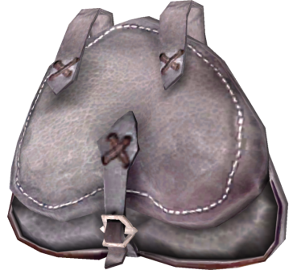
Work backwards
Value = £5
Weight = 3kg
5kg
Keep | 0 | 1 | 2 | 3 | 4 | 5
0 | 0 | 0 | 0 | 0 | 0 | 0
1 | 0 | 0 | 1 | 1 | 1 | 1
2 | 0 | 0 | 1 | 0 | 0 | 1
3 | 0 | 1 | 1 | 1 | 1 | 1
Value = £3
Weight = 2kg
Value = £4
Weight = 1kg

Slide 31
Work backwards
Value = £5
Weight = 3kg
5kg
Keep | 0 | 1 | 2 | 3 | 4 | 5
0 | 0 | 0 | 0 | 0 | 0 | 0
1 | 0 | 0 | 1 | 1 | 1 | 1
2 | 0 | 0 | 1 | 0 | 0 | 1
3 | 0 | 1 | 1 | 1 | 1 | 1
Value = £3
Weight = 2kg
Value = £4
Weight = 1kg

Slide 32
Work backwards
Value = £5
Weight = 3kg
4kg
Keep | 0 | 1 | 2 | 3 | 4 | 5
0 | 0 | 0 | 0 | 0 | 0 | 0
1 | 0 | 0 | 1 | 1 | 1 | 1
2 | 0 | 0 | 1 | 0 | 0 | 1
3 | 0 | 1 | 1 | 1 | 1 | 1
Value = £3
Weight = 2kg
Value = £4
Weight = 1kg
✔

Slide 33
Work backwards
Value = £5
Weight = 3kg
4kg
Keep | 0 | 1 | 2 | 3 | 4 | 5
0 | 0 | 0 | 0 | 0 | 0 | 0
1 | 0 | 0 | 1 | 1 | 1 | 1
2 | 0 | 0 | 1 | 0 | 0 | 1
3 | 0 | 1 | 1 | 1 | 1 | 1
Value = £3
Weight = 2kg
Value = £4
Weight = 1kg
✔

Slide 34
Work backwards
Value = £5
Weight = 3kg
4kg
Keep | 0 | 1 | 2 | 3 | 4 | 5
0 | 0 | 0 | 0 | 0 | 0 | 0
1 | 0 | 0 | 1 | 1 | 1 | 1
2 | 0 | 0 | 1 | 0 | 0 | 1
3 | 0 | 1 | 1 | 1 | 1 | 1
Value = £3
Weight = 2kg
✘
Value = £4
Weight = 1kg
✔

Slide 35
Work backwards
Value = £5
Weight = 3kg
4kg
Keep | 0 | 1 | 2 | 3 | 4 | 5
0 | 0 | 0 | 0 | 0 | 0 | 0
1 | 0 | 0 | 1 | 1 | 1 | 1
2 | 0 | 0 | 1 | 0 | 0 | 1
3 | 0 | 1 | 1 | 1 | 1 | 1
Value = £3
Weight = 2kg
✘
Value = £4
Weight = 1kg
✔

Slide 36
Work backwards
Value = £5
Weight = 3kg
✔
1kg
Keep | 0 | 1 | 2 | 3 | 4 | 5
0 | 0 | 0 | 0 | 0 | 0 | 0
1 | 0 | 0 | 1 | 1 | 1 | 1
2 | 0 | 0 | 1 | 0 | 0 | 1
3 | 0 | 1 | 1 | 1 | 1 | 1
Value = £3
Weight = 2kg
✘
Value = £4
Weight = 1kg
✔

Slide 37
Have a go!

Slide 38
KEEP | 0 | 1 | 2 | 3 | 4 | 5 | 6 | 7 | 8 | 9 | 10 | 11 | 12 | 13 | 14 | 15 | 16 | 17 | 18
None | 0 | 0 | 0 | 0 | 0 | 0 | 0 | 0 | 0 | 0 | 0 | 0 | 0 | 0 | 0 | 0 | 0 | 0 | 0
Item 1 | 0 | 0 | 0 | 0 | 1 | 1 | 1 | 1 | 1 | 1 | 1 | 1 | 1 | 1 | 1 | 1 | 1 | 1 | 1
Item 2 | 0 | 0 | 0 | 0 | 0 | 0 | 0 | 0 | 0 | 0 | 1 | 1 | 1 | 1 | 1 | 1 | 1 | 1 | 1
Item 3 | 0 | 0 | 0 | 0 | 0 | 0 | 0 | 0 | 0 | 1 | 0 | 0 | 0 | 0 | 0 | 1 | 1 | 1 | 1
Item 4 | 0 | 0 | 0 | 0 | 0 | 0 | 0 | 0 | 0 | 0 | 0 | 1 | 1 | 1 | 1 | 0 | 1 | 1 | 1
Item 5 | 0 | 0 | 0 | 1 | 1 | 1 | 1 | 1 | 1 | 1 | 1 | 1 | 1 | 1 | 1 | 1 | 1 | 1 | 1
Item 6 | 0 | 1 | 1 | 0 | 1 | 1 | 1 | 0 | 1 | 1 | 1 | 1 | 0 | 1 | 1 | 1 | 1 | 1 | 0
Item 7 | 0 | 0 | 0 | 0 | 0 | 0 | 0 | 0 | 0 | 0 | 0 | 0 | 0 | 0 | 0 | 0 | 0 | 0 | 0
18kg
 | Item 1 | Item 2 | Item 3 | Item 4 | Item 5 | Item 6 | Item 7
Value | £12 | £10 | £8 | £11 | £14 | £7 | £9
Weight | 4kg | 6kg | 5kg | 7kg | 3kg | 1kg | 6kg
Question: Which items should we take in the knapsack?
Hints: Work backwards! (Item 7 – Item 1)
Update the weight of the knapsack!
Notes:
Keep matrix.

Slide 39
KEEP | 0 | 1 | 2 | 3 | 4 | 5 | 6 | 7 | 8 | 9 | 10 | 11 | 12 | 13 | 14 | 15 | 16 | 17 | 18
None | 0 | 0 | 0 | 0 | 0 | 0 | 0 | 0 | 0 | 0 | 0 | 0 | 0 | 0 | 0 | 0 | 0 | 0 | 0
Item 1 | 0 | 0 | 0 | 0 | 1 | 1 | 1 | 1 | 1 | 1 | 1 | 1 | 1 | 1 | 1 | 1 | 1 | 1 | 1
Item 2 | 0 | 0 | 0 | 0 | 0 | 0 | 0 | 0 | 0 | 0 | 1 | 1 | 1 | 1 | 1 | 1 | 1 | 1 | 1
Item 3 | 0 | 0 | 0 | 0 | 0 | 0 | 0 | 0 | 0 | 1 | 0 | 0 | 0 | 0 | 0 | 1 | 1 | 1 | 1
Item 4 | 0 | 0 | 0 | 0 | 0 | 0 | 0 | 0 | 0 | 0 | 0 | 1 | 1 | 1 | 1 | 0 | 1 | 1 | 1
Item 5 | 0 | 0 | 0 | 1 | 1 | 1 | 1 | 1 | 1 | 1 | 1 | 1 | 1 | 1 | 1 | 1 | 1 | 1 | 1
Item 6 | 0 | 1 | 1 | 0 | 1 | 1 | 1 | 0 | 1 | 1 | 1 | 1 | 0 | 1 | 1 | 1 | 1 | 1 | 0
Item 7 | 0 | 0 | 0 | 0 | 0 | 0 | 0 | 0 | 0 | 0 | 0 | 0 | 0 | 0 | 0 | 0 | 0 | 0 | 0
18kg
 | Item 1 | Item 2 | Item 3 | Item 4 | Item 5 | Item 6 | Item 7
Value | £12 | £10 | £8 | £11 | £14 | £7 | £9
Weight | 4kg | 6kg | 5kg | 7kg | 3kg | 1kg | 6kg
 |  |  |  |  |  |  | ?
Notes:
Keep matrix.

Slide 40
KEEP | 0 | 1 | 2 | 3 | 4 | 5 | 6 | 7 | 8 | 9 | 10 | 11 | 12 | 13 | 14 | 15 | 16 | 17 | 18
None | 0 | 0 | 0 | 0 | 0 | 0 | 0 | 0 | 0 | 0 | 0 | 0 | 0 | 0 | 0 | 0 | 0 | 0 | 0
Item 1 | 0 | 0 | 0 | 0 | 1 | 1 | 1 | 1 | 1 | 1 | 1 | 1 | 1 | 1 | 1 | 1 | 1 | 1 | 1
Item 2 | 0 | 0 | 0 | 0 | 0 | 0 | 0 | 0 | 0 | 0 | 1 | 1 | 1 | 1 | 1 | 1 | 1 | 1 | 1
Item 3 | 0 | 0 | 0 | 0 | 0 | 0 | 0 | 0 | 0 | 1 | 0 | 0 | 0 | 0 | 0 | 1 | 1 | 1 | 1
Item 4 | 0 | 0 | 0 | 0 | 0 | 0 | 0 | 0 | 0 | 0 | 0 | 1 | 1 | 1 | 1 | 0 | 1 | 1 | 1
Item 5 | 0 | 0 | 0 | 1 | 1 | 1 | 1 | 1 | 1 | 1 | 1 | 1 | 1 | 1 | 1 | 1 | 1 | 1 | 1
Item 6 | 0 | 1 | 1 | 0 | 1 | 1 | 1 | 0 | 1 | 1 | 1 | 1 | 0 | 1 | 1 | 1 | 1 | 1 | 0
Item 7 | 0 | 0 | 0 | 0 | 0 | 0 | 0 | 0 | 0 | 0 | 0 | 0 | 0 | 0 | 0 | 0 | 0 | 0 | 0
18kg
 | Item 1 | Item 2 | Item 3 | Item 4 | Item 5 | Item 6 | Item 7
Value | £12 | £10 | £8 | £11 | £14 | £7 | £9
Weight | 4kg | 6kg | 5kg | 7kg | 3kg | 1kg | 6kg
 |  |  |  |  |  |  | ✘
Notes:
Keep matrix.

Slide 41
KEEP | 0 | 1 | 2 | 3 | 4 | 5 | 6 | 7 | 8 | 9 | 10 | 11 | 12 | 13 | 14 | 15 | 16 | 17 | 18
None | 0 | 0 | 0 | 0 | 0 | 0 | 0 | 0 | 0 | 0 | 0 | 0 | 0 | 0 | 0 | 0 | 0 | 0 | 0
Item 1 | 0 | 0 | 0 | 0 | 1 | 1 | 1 | 1 | 1 | 1 | 1 | 1 | 1 | 1 | 1 | 1 | 1 | 1 | 1
Item 2 | 0 | 0 | 0 | 0 | 0 | 0 | 0 | 0 | 0 | 0 | 1 | 1 | 1 | 1 | 1 | 1 | 1 | 1 | 1
Item 3 | 0 | 0 | 0 | 0 | 0 | 0 | 0 | 0 | 0 | 1 | 0 | 0 | 0 | 0 | 0 | 1 | 1 | 1 | 1
Item 4 | 0 | 0 | 0 | 0 | 0 | 0 | 0 | 0 | 0 | 0 | 0 | 1 | 1 | 1 | 1 | 0 | 1 | 1 | 1
Item 5 | 0 | 0 | 0 | 1 | 1 | 1 | 1 | 1 | 1 | 1 | 1 | 1 | 1 | 1 | 1 | 1 | 1 | 1 | 1
Item 6 | 0 | 1 | 1 | 0 | 1 | 1 | 1 | 0 | 1 | 1 | 1 | 1 | 0 | 1 | 1 | 1 | 1 | 1 | 0
Item 7 | 0 | 0 | 0 | 0 | 0 | 0 | 0 | 0 | 0 | 0 | 0 | 0 | 0 | 0 | 0 | 0 | 0 | 0 | 0
18kg
 | Item 1 | Item 2 | Item 3 | Item 4 | Item 5 | Item 6 | Item 7
Value | £12 | £10 | £8 | £11 | £14 | £7 | £9
Weight | 4kg | 6kg | 5kg | 7kg | 3kg | 1kg | 6kg
 |  |  |  |  |  | ? | ✘
Notes:
Keep matrix.

Slide 42
KEEP | 0 | 1 | 2 | 3 | 4 | 5 | 6 | 7 | 8 | 9 | 10 | 11 | 12 | 13 | 14 | 15 | 16 | 17 | 18
None | 0 | 0 | 0 | 0 | 0 | 0 | 0 | 0 | 0 | 0 | 0 | 0 | 0 | 0 | 0 | 0 | 0 | 0 | 0
Item 1 | 0 | 0 | 0 | 0 | 1 | 1 | 1 | 1 | 1 | 1 | 1 | 1 | 1 | 1 | 1 | 1 | 1 | 1 | 1
Item 2 | 0 | 0 | 0 | 0 | 0 | 0 | 0 | 0 | 0 | 0 | 1 | 1 | 1 | 1 | 1 | 1 | 1 | 1 | 1
Item 3 | 0 | 0 | 0 | 0 | 0 | 0 | 0 | 0 | 0 | 1 | 0 | 0 | 0 | 0 | 0 | 1 | 1 | 1 | 1
Item 4 | 0 | 0 | 0 | 0 | 0 | 0 | 0 | 0 | 0 | 0 | 0 | 1 | 1 | 1 | 1 | 0 | 1 | 1 | 1
Item 5 | 0 | 0 | 0 | 1 | 1 | 1 | 1 | 1 | 1 | 1 | 1 | 1 | 1 | 1 | 1 | 1 | 1 | 1 | 1
Item 6 | 0 | 1 | 1 | 0 | 1 | 1 | 1 | 0 | 1 | 1 | 1 | 1 | 0 | 1 | 1 | 1 | 1 | 1 | 0
Item 7 | 0 | 0 | 0 | 0 | 0 | 0 | 0 | 0 | 0 | 0 | 0 | 0 | 0 | 0 | 0 | 0 | 0 | 0 | 0
18kg
 | Item 1 | Item 2 | Item 3 | Item 4 | Item 5 | Item 6 | Item 7
Value | £12 | £10 | £8 | £11 | £14 | £7 | £9
Weight | 4kg | 6kg | 5kg | 7kg | 3kg | 1kg | 6kg
 |  |  |  |  |  | ✘ | ✘
Notes:
Keep matrix.

Slide 43
KEEP | 0 | 1 | 2 | 3 | 4 | 5 | 6 | 7 | 8 | 9 | 10 | 11 | 12 | 13 | 14 | 15 | 16 | 17 | 18
None | 0 | 0 | 0 | 0 | 0 | 0 | 0 | 0 | 0 | 0 | 0 | 0 | 0 | 0 | 0 | 0 | 0 | 0 | 0
Item 1 | 0 | 0 | 0 | 0 | 1 | 1 | 1 | 1 | 1 | 1 | 1 | 1 | 1 | 1 | 1 | 1 | 1 | 1 | 1
Item 2 | 0 | 0 | 0 | 0 | 0 | 0 | 0 | 0 | 0 | 0 | 1 | 1 | 1 | 1 | 1 | 1 | 1 | 1 | 1
Item 3 | 0 | 0 | 0 | 0 | 0 | 0 | 0 | 0 | 0 | 1 | 0 | 0 | 0 | 0 | 0 | 1 | 1 | 1 | 1
Item 4 | 0 | 0 | 0 | 0 | 0 | 0 | 0 | 0 | 0 | 0 | 0 | 1 | 1 | 1 | 1 | 0 | 1 | 1 | 1
Item 5 | 0 | 0 | 0 | 1 | 1 | 1 | 1 | 1 | 1 | 1 | 1 | 1 | 1 | 1 | 1 | 1 | 1 | 1 | 1
Item 6 | 0 | 1 | 1 | 0 | 1 | 1 | 1 | 0 | 1 | 1 | 1 | 1 | 0 | 1 | 1 | 1 | 1 | 1 | 0
Item 7 | 0 | 0 | 0 | 0 | 0 | 0 | 0 | 0 | 0 | 0 | 0 | 0 | 0 | 0 | 0 | 0 | 0 | 0 | 0
18kg
 | Item 1 | Item 2 | Item 3 | Item 4 | Item 5 | Item 6 | Item 7
Value | £12 | £10 | £8 | £11 | £14 | £7 | £9
Weight | 4kg | 6kg | 5kg | 7kg | 3kg | 1kg | 6kg
 |  |  |  |  | ? | ✘ | ✘
Notes:
Keep matrix.

Slide 44
KEEP | 0 | 1 | 2 | 3 | 4 | 5 | 6 | 7 | 8 | 9 | 10 | 11 | 12 | 13 | 14 | 15 | 16 | 17 | 18
None | 0 | 0 | 0 | 0 | 0 | 0 | 0 | 0 | 0 | 0 | 0 | 0 | 0 | 0 | 0 | 0 | 0 | 0 | 0
Item 1 | 0 | 0 | 0 | 0 | 1 | 1 | 1 | 1 | 1 | 1 | 1 | 1 | 1 | 1 | 1 | 1 | 1 | 1 | 1
Item 2 | 0 | 0 | 0 | 0 | 0 | 0 | 0 | 0 | 0 | 0 | 1 | 1 | 1 | 1 | 1 | 1 | 1 | 1 | 1
Item 3 | 0 | 0 | 0 | 0 | 0 | 0 | 0 | 0 | 0 | 1 | 0 | 0 | 0 | 0 | 0 | 1 | 1 | 1 | 1
Item 4 | 0 | 0 | 0 | 0 | 0 | 0 | 0 | 0 | 0 | 0 | 0 | 1 | 1 | 1 | 1 | 0 | 1 | 1 | 1
Item 5 | 0 | 0 | 0 | 1 | 1 | 1 | 1 | 1 | 1 | 1 | 1 | 1 | 1 | 1 | 1 | 1 | 1 | 1 | 1
Item 6 | 0 | 1 | 1 | 0 | 1 | 1 | 1 | 0 | 1 | 1 | 1 | 1 | 0 | 1 | 1 | 1 | 1 | 1 | 0
Item 7 | 0 | 0 | 0 | 0 | 0 | 0 | 0 | 0 | 0 | 0 | 0 | 0 | 0 | 0 | 0 | 0 | 0 | 0 | 0
15kg
 | Item 1 | Item 2 | Item 3 | Item 4 | Item 5 | Item 6 | Item 7
Value | £12 | £10 | £8 | £11 | £14 | £7 | £9
Weight | 4kg | 6kg | 5kg | 7kg | 3kg | 1kg | 6kg
 |  |  |  |  | ✔ | ✘ | ✘
Notes:
Keep matrix.

Slide 45
KEEP | 0 | 1 | 2 | 3 | 4 | 5 | 6 | 7 | 8 | 9 | 10 | 11 | 12 | 13 | 14 | 15 | 16 | 17 | 18
None | 0 | 0 | 0 | 0 | 0 | 0 | 0 | 0 | 0 | 0 | 0 | 0 | 0 | 0 | 0 | 0 | 0 | 0 | 0
Item 1 | 0 | 0 | 0 | 0 | 1 | 1 | 1 | 1 | 1 | 1 | 1 | 1 | 1 | 1 | 1 | 1 | 1 | 1 | 1
Item 2 | 0 | 0 | 0 | 0 | 0 | 0 | 0 | 0 | 0 | 0 | 1 | 1 | 1 | 1 | 1 | 1 | 1 | 1 | 1
Item 3 | 0 | 0 | 0 | 0 | 0 | 0 | 0 | 0 | 0 | 1 | 0 | 0 | 0 | 0 | 0 | 1 | 1 | 1 | 1
Item 4 | 0 | 0 | 0 | 0 | 0 | 0 | 0 | 0 | 0 | 0 | 0 | 1 | 1 | 1 | 1 | 0 | 1 | 1 | 1
Item 5 | 0 | 0 | 0 | 1 | 1 | 1 | 1 | 1 | 1 | 1 | 1 | 1 | 1 | 1 | 1 | 1 | 1 | 1 | 1
Item 6 | 0 | 1 | 1 | 0 | 1 | 1 | 1 | 0 | 1 | 1 | 1 | 1 | 0 | 1 | 1 | 1 | 1 | 1 | 0
Item 7 | 0 | 0 | 0 | 0 | 0 | 0 | 0 | 0 | 0 | 0 | 0 | 0 | 0 | 0 | 0 | 0 | 0 | 0 | 0
15kg
 | Item 1 | Item 2 | Item 3 | Item 4 | Item 5 | Item 6 | Item 7
Value | £12 | £10 | £8 | £11 | £14 | £7 | £9
Weight | 4kg | 6kg | 5kg | 7kg | 3kg | 1kg | 6kg
 |  |  |  | ? | ✔ | ✘ | ✘
Notes:
Keep matrix.

Slide 46
KEEP | 0 | 1 | 2 | 3 | 4 | 5 | 6 | 7 | 8 | 9 | 10 | 11 | 12 | 13 | 14 | 15 | 16 | 17 | 18
None | 0 | 0 | 0 | 0 | 0 | 0 | 0 | 0 | 0 | 0 | 0 | 0 | 0 | 0 | 0 | 0 | 0 | 0 | 0
Item 1 | 0 | 0 | 0 | 0 | 1 | 1 | 1 | 1 | 1 | 1 | 1 | 1 | 1 | 1 | 1 | 1 | 1 | 1 | 1
Item 2 | 0 | 0 | 0 | 0 | 0 | 0 | 0 | 0 | 0 | 0 | 1 | 1 | 1 | 1 | 1 | 1 | 1 | 1 | 1
Item 3 | 0 | 0 | 0 | 0 | 0 | 0 | 0 | 0 | 0 | 1 | 0 | 0 | 0 | 0 | 0 | 1 | 1 | 1 | 1
Item 4 | 0 | 0 | 0 | 0 | 0 | 0 | 0 | 0 | 0 | 0 | 0 | 1 | 1 | 1 | 1 | 0 | 1 | 1 | 1
Item 5 | 0 | 0 | 0 | 1 | 1 | 1 | 1 | 1 | 1 | 1 | 1 | 1 | 1 | 1 | 1 | 1 | 1 | 1 | 1
Item 6 | 0 | 1 | 1 | 0 | 1 | 1 | 1 | 0 | 1 | 1 | 1 | 1 | 0 | 1 | 1 | 1 | 1 | 1 | 0
Item 7 | 0 | 0 | 0 | 0 | 0 | 0 | 0 | 0 | 0 | 0 | 0 | 0 | 0 | 0 | 0 | 0 | 0 | 0 | 0
15kg
 | Item 1 | Item 2 | Item 3 | Item 4 | Item 5 | Item 6 | Item 7
Value | £12 | £10 | £8 | £11 | £14 | £7 | £9
Weight | 4kg | 6kg | 5kg | 7kg | 3kg | 1kg | 6kg
 |  |  |  | ✘ | ✔ | ✘ | ✘
Notes:
Keep matrix.

Slide 47
KEEP | 0 | 1 | 2 | 3 | 4 | 5 | 6 | 7 | 8 | 9 | 10 | 11 | 12 | 13 | 14 | 15 | 16 | 17 | 18
None | 0 | 0 | 0 | 0 | 0 | 0 | 0 | 0 | 0 | 0 | 0 | 0 | 0 | 0 | 0 | 0 | 0 | 0 | 0
Item 1 | 0 | 0 | 0 | 0 | 1 | 1 | 1 | 1 | 1 | 1 | 1 | 1 | 1 | 1 | 1 | 1 | 1 | 1 | 1
Item 2 | 0 | 0 | 0 | 0 | 0 | 0 | 0 | 0 | 0 | 0 | 1 | 1 | 1 | 1 | 1 | 1 | 1 | 1 | 1
Item 3 | 0 | 0 | 0 | 0 | 0 | 0 | 0 | 0 | 0 | 1 | 0 | 0 | 0 | 0 | 0 | 1 | 1 | 1 | 1
Item 4 | 0 | 0 | 0 | 0 | 0 | 0 | 0 | 0 | 0 | 0 | 0 | 1 | 1 | 1 | 1 | 0 | 1 | 1 | 1
Item 5 | 0 | 0 | 0 | 1 | 1 | 1 | 1 | 1 | 1 | 1 | 1 | 1 | 1 | 1 | 1 | 1 | 1 | 1 | 1
Item 6 | 0 | 1 | 1 | 0 | 1 | 1 | 1 | 0 | 1 | 1 | 1 | 1 | 0 | 1 | 1 | 1 | 1 | 1 | 0
Item 7 | 0 | 0 | 0 | 0 | 0 | 0 | 0 | 0 | 0 | 0 | 0 | 0 | 0 | 0 | 0 | 0 | 0 | 0 | 0
15kg
 | Item 1 | Item 2 | Item 3 | Item 4 | Item 5 | Item 6 | Item 7
Value | £12 | £10 | £8 | £11 | £14 | £7 | £9
Weight | 4kg | 6kg | 5kg | 7kg | 3kg | 1kg | 6kg
 |  |  | ? | ✘ | ✔ | ✘ | ✘
Notes:
Keep matrix.

Slide 48
KEEP | 0 | 1 | 2 | 3 | 4 | 5 | 6 | 7 | 8 | 9 | 10 | 11 | 12 | 13 | 14 | 15 | 16 | 17 | 18
None | 0 | 0 | 0 | 0 | 0 | 0 | 0 | 0 | 0 | 0 | 0 | 0 | 0 | 0 | 0 | 0 | 0 | 0 | 0
Item 1 | 0 | 0 | 0 | 0 | 1 | 1 | 1 | 1 | 1 | 1 | 1 | 1 | 1 | 1 | 1 | 1 | 1 | 1 | 1
Item 2 | 0 | 0 | 0 | 0 | 0 | 0 | 0 | 0 | 0 | 0 | 1 | 1 | 1 | 1 | 1 | 1 | 1 | 1 | 1
Item 3 | 0 | 0 | 0 | 0 | 0 | 0 | 0 | 0 | 0 | 1 | 0 | 0 | 0 | 0 | 0 | 1 | 1 | 1 | 1
Item 4 | 0 | 0 | 0 | 0 | 0 | 0 | 0 | 0 | 0 | 0 | 0 | 1 | 1 | 1 | 1 | 0 | 1 | 1 | 1
Item 5 | 0 | 0 | 0 | 1 | 1 | 1 | 1 | 1 | 1 | 1 | 1 | 1 | 1 | 1 | 1 | 1 | 1 | 1 | 1
Item 6 | 0 | 1 | 1 | 0 | 1 | 1 | 1 | 0 | 1 | 1 | 1 | 1 | 0 | 1 | 1 | 1 | 1 | 1 | 0
Item 7 | 0 | 0 | 0 | 0 | 0 | 0 | 0 | 0 | 0 | 0 | 0 | 0 | 0 | 0 | 0 | 0 | 0 | 0 | 0
10kg
 | Item 1 | Item 2 | Item 3 | Item 4 | Item 5 | Item 6 | Item 7
Value | £12 | £10 | £8 | £11 | £14 | £7 | £9
Weight | 4kg | 6kg | 5kg | 7kg | 3kg | 1kg | 6kg
 |  |  | ✔ | ✘ | ✔ | ✘ | ✘
Notes:
Keep matrix.

Slide 49
KEEP | 0 | 1 | 2 | 3 | 4 | 5 | 6 | 7 | 8 | 9 | 10 | 11 | 12 | 13 | 14 | 15 | 16 | 17 | 18
None | 0 | 0 | 0 | 0 | 0 | 0 | 0 | 0 | 0 | 0 | 0 | 0 | 0 | 0 | 0 | 0 | 0 | 0 | 0
Item 1 | 0 | 0 | 0 | 0 | 1 | 1 | 1 | 1 | 1 | 1 | 1 | 1 | 1 | 1 | 1 | 1 | 1 | 1 | 1
Item 2 | 0 | 0 | 0 | 0 | 0 | 0 | 0 | 0 | 0 | 0 | 1 | 1 | 1 | 1 | 1 | 1 | 1 | 1 | 1
Item 3 | 0 | 0 | 0 | 0 | 0 | 0 | 0 | 0 | 0 | 1 | 0 | 0 | 0 | 0 | 0 | 1 | 1 | 1 | 1
Item 4 | 0 | 0 | 0 | 0 | 0 | 0 | 0 | 0 | 0 | 0 | 0 | 1 | 1 | 1 | 1 | 0 | 1 | 1 | 1
Item 5 | 0 | 0 | 0 | 1 | 1 | 1 | 1 | 1 | 1 | 1 | 1 | 1 | 1 | 1 | 1 | 1 | 1 | 1 | 1
Item 6 | 0 | 1 | 1 | 0 | 1 | 1 | 1 | 0 | 1 | 1 | 1 | 1 | 0 | 1 | 1 | 1 | 1 | 1 | 0
Item 7 | 0 | 0 | 0 | 0 | 0 | 0 | 0 | 0 | 0 | 0 | 0 | 0 | 0 | 0 | 0 | 0 | 0 | 0 | 0
10kg
 | Item 1 | Item 2 | Item 3 | Item 4 | Item 5 | Item 6 | Item 7
Value | £12 | £10 | £8 | £11 | £14 | £7 | £9
Weight | 4kg | 6kg | 5kg | 7kg | 3kg | 1kg | 6kg
 |  | ? | ✔ | ✘ | ✔ | ✘ | ✘
Notes:
Keep matrix.

Slide 50
KEEP | 0 | 1 | 2 | 3 | 4 | 5 | 6 | 7 | 8 | 9 | 10 | 11 | 12 | 13 | 14 | 15 | 16 | 17 | 18
None | 0 | 0 | 0 | 0 | 0 | 0 | 0 | 0 | 0 | 0 | 0 | 0 | 0 | 0 | 0 | 0 | 0 | 0 | 0
Item 1 | 0 | 0 | 0 | 0 | 1 | 1 | 1 | 1 | 1 | 1 | 1 | 1 | 1 | 1 | 1 | 1 | 1 | 1 | 1
Item 2 | 0 | 0 | 0 | 0 | 0 | 0 | 0 | 0 | 0 | 0 | 1 | 1 | 1 | 1 | 1 | 1 | 1 | 1 | 1
Item 3 | 0 | 0 | 0 | 0 | 0 | 0 | 0 | 0 | 0 | 1 | 0 | 0 | 0 | 0 | 0 | 1 | 1 | 1 | 1
Item 4 | 0 | 0 | 0 | 0 | 0 | 0 | 0 | 0 | 0 | 0 | 0 | 1 | 1 | 1 | 1 | 0 | 1 | 1 | 1
Item 5 | 0 | 0 | 0 | 1 | 1 | 1 | 1 | 1 | 1 | 1 | 1 | 1 | 1 | 1 | 1 | 1 | 1 | 1 | 1
Item 6 | 0 | 1 | 1 | 0 | 1 | 1 | 1 | 0 | 1 | 1 | 1 | 1 | 0 | 1 | 1 | 1 | 1 | 1 | 0
Item 7 | 0 | 0 | 0 | 0 | 0 | 0 | 0 | 0 | 0 | 0 | 0 | 0 | 0 | 0 | 0 | 0 | 0 | 0 | 0
4kg
 | Item 1 | Item 2 | Item 3 | Item 4 | Item 5 | Item 6 | Item 7
Value | £12 | £10 | £8 | £11 | £14 | £7 | £9
Weight | 4kg | 6kg | 5kg | 7kg | 3kg | 1kg | 6kg
 |  | ✔ | ✔ | ✘ | ✔ | ✘ | ✘
Notes:
Keep matrix.

Slide 51
KEEP | 0 | 1 | 2 | 3 | 4 | 5 | 6 | 7 | 8 | 9 | 10 | 11 | 12 | 13 | 14 | 15 | 16 | 17 | 18
None | 0 | 0 | 0 | 0 | 0 | 0 | 0 | 0 | 0 | 0 | 0 | 0 | 0 | 0 | 0 | 0 | 0 | 0 | 0
Item 1 | 0 | 0 | 0 | 0 | 1 | 1 | 1 | 1 | 1 | 1 | 1 | 1 | 1 | 1 | 1 | 1 | 1 | 1 | 1
Item 2 | 0 | 0 | 0 | 0 | 0 | 0 | 0 | 0 | 0 | 0 | 1 | 1 | 1 | 1 | 1 | 1 | 1 | 1 | 1
Item 3 | 0 | 0 | 0 | 0 | 0 | 0 | 0 | 0 | 0 | 1 | 0 | 0 | 0 | 0 | 0 | 1 | 1 | 1 | 1
Item 4 | 0 | 0 | 0 | 0 | 0 | 0 | 0 | 0 | 0 | 0 | 0 | 1 | 1 | 1 | 1 | 0 | 1 | 1 | 1
Item 5 | 0 | 0 | 0 | 1 | 1 | 1 | 1 | 1 | 1 | 1 | 1 | 1 | 1 | 1 | 1 | 1 | 1 | 1 | 1
Item 6 | 0 | 1 | 1 | 0 | 1 | 1 | 1 | 0 | 1 | 1 | 1 | 1 | 0 | 1 | 1 | 1 | 1 | 1 | 0
Item 7 | 0 | 0 | 0 | 0 | 0 | 0 | 0 | 0 | 0 | 0 | 0 | 0 | 0 | 0 | 0 | 0 | 0 | 0 | 0
4kg
 | Item 1 | Item 2 | Item 3 | Item 4 | Item 5 | Item 6 | Item 7
Value | £12 | £10 | £8 | £11 | £14 | £7 | £9
Weight | 4kg | 6kg | 5kg | 7kg | 3kg | 1kg | 6kg
 | ? | ✔ | ✔ | ✘ | ✔ | ✘ | ✘
Notes:
Keep matrix.

Slide 52
KEEP | 0 | 1 | 2 | 3 | 4 | 5 | 6 | 7 | 8 | 9 | 10 | 11 | 12 | 13 | 14 | 15 | 16 | 17 | 18
None | 0 | 0 | 0 | 0 | 0 | 0 | 0 | 0 | 0 | 0 | 0 | 0 | 0 | 0 | 0 | 0 | 0 | 0 | 0
Item 1 | 0 | 0 | 0 | 0 | 1 | 1 | 1 | 1 | 1 | 1 | 1 | 1 | 1 | 1 | 1 | 1 | 1 | 1 | 1
Item 2 | 0 | 0 | 0 | 0 | 0 | 0 | 0 | 0 | 0 | 0 | 1 | 1 | 1 | 1 | 1 | 1 | 1 | 1 | 1
Item 3 | 0 | 0 | 0 | 0 | 0 | 0 | 0 | 0 | 0 | 1 | 0 | 0 | 0 | 0 | 0 | 1 | 1 | 1 | 1
Item 4 | 0 | 0 | 0 | 0 | 0 | 0 | 0 | 0 | 0 | 0 | 0 | 1 | 1 | 1 | 1 | 0 | 1 | 1 | 1
Item 5 | 0 | 0 | 0 | 1 | 1 | 1 | 1 | 1 | 1 | 1 | 1 | 1 | 1 | 1 | 1 | 1 | 1 | 1 | 1
Item 6 | 0 | 1 | 1 | 0 | 1 | 1 | 1 | 0 | 1 | 1 | 1 | 1 | 0 | 1 | 1 | 1 | 1 | 1 | 0
Item 7 | 0 | 0 | 0 | 0 | 0 | 0 | 0 | 0 | 0 | 0 | 0 | 0 | 0 | 0 | 0 | 0 | 0 | 0 | 0
4kg
 | Item 1 | Item 2 | Item 3 | Item 4 | Item 5 | Item 6 | Item 7
Value | £12 | £10 | £8 | £11 | £14 | £7 | £9
Weight | 4kg | 6kg | 5kg | 7kg | 3kg | 1kg | 6kg
 | ✔ | ✔ | ✔ | ✘ | ✔ | ✘ | ✘
Notes:
Keep matrix.

